Slide 1
Code Coverage

Slide 2
Quick introduction
What is code Coverage?
Code coverage is a software testing metric that determines the number of lines of code that is successfully validated under a test procedure, which in turn, helps in analyzing how comprehensively a software is verified.
Code coverage is one such software testing metric that can help in assessing the test performance and quality aspects of any software.
Code coverage analysis can only be used for the validation of test cases that are run on the source code and not for the evaluation of the software product. Also, it neither evaluates whether the source code is bug-free nor proves if a written code is correct.

Slide 3
Quick introduction
Some benefits of code coverage:
Easy maintenance of code base - The analysis report will help developers to ensure code quality is well-maintained and new features can be added with little-to-no efforts.
Exposure of bad code – Continuous analysis will help developers to understand bad, dead, and unused code. As a result, they can improve code-writing practices, which in turn, will result in better maintainability of the product quality.
Faster time to market – With the help of this metric, developers can finish the software development process faster, thereby increasing their productivity and efficiency.

Slide 4
Coverage methods

Slide 5
Statement coverage measures percentage of code statements executed during a test suite
The different coverage methods that we will discuss
There are many code coverage methods, but we will talk about the 3 basic ones, due to our limited time.
Branch coverage measures percentage of code path-branch executed during a test suite
Condition coverage measures percentage of Condition
total coverage executed
during a test suite

Slide 6
Consider the next code:
1.Prints (int a, int b) {
2. int result = a+ b;
3. If (result> 0 & a>0)
4. Print ("Positive", result)
5. Else
6. Print ("Negative", result)
7. Print("done")
8. }
And our test suit will be a single test case: Prints(3,9)

Slide 7
Statement coverage
1

Slide 8
Statement coverage
Statements are instructions in the code expressing some action that the program should carry out.
measures the percentage of code statements executed during a test suite. statement coverage gives an accurate measure of the quantity of written code that tests actually execute.

Slide 9
In our example:
1.Prints (int a, int b) {
2. int result = a+ b;
3. If (result> 0 & a>0)
4. Print ("Positive", result)
5. Else
6. Print ("Negative", result)
7. Print("done")
8.}
Prints(3,9) the code coverage will be 75% because in such case only 6/8 lines of code were validated in the run of the test suit.

Slide 10
Advantages and disadvantages:
Advantages:
It verifies what the written code is expected to do and not to do
It measures the quality of code written
It checks the flow of different paths in the program, and it also ensure that whether those path are tested or not.
Disadvantages:
It does not report that whether the loop reaches its termination condition.
It does not understand the logical operators.

Slide 11
Branch coverage
2

Slide 12
Branch coverage
Branch - one of the possible execution paths the code can take after a decision statement
The purpose of branch coverage is to ensure that each decision condition from every branch is executed at least once. It helps to measure fractions of independent code segments and to find out sections having no branches.

Slide 13
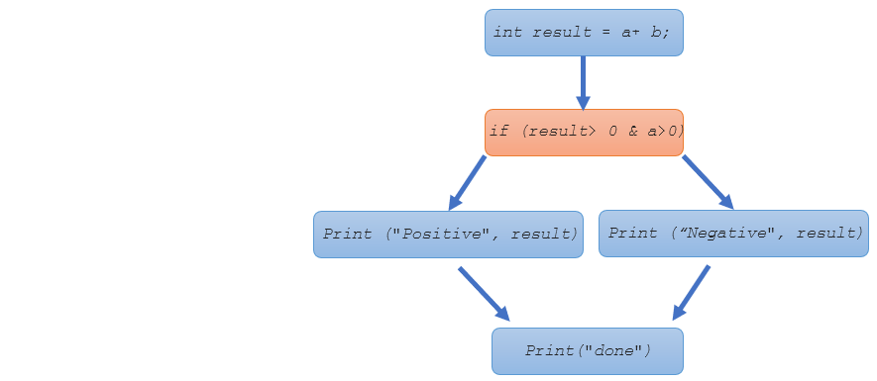
In our example:
1.Prints (int a, int b) {
2. int result = a+ b;
3. If (result> 0 & a>0)
4. Print ("Positive", result)
5. Else
6. Print ("Negative", result)
7. Print("done")
8.}
Prints(3,9) the code coverage will be 50% because in such case only one possible path is checked out of two.

Slide 14
Advantages and disadvantages:
Advantages:
Helps you to ensure that no branched lead to any abnormality of the program’s operation.
Unlike statement coverage, branch coverage allows us to know how ,any times a loop executed.
It allows you to find a quantitative measure of code coverage
Disadvantages:
These metric disregards branches inside Boolean expressions which happen because of short-circuiting administrators.
Demands a tracking of the returned value in each decision statement.

Slide 15
Condition coverage
3

Slide 16
Condition coverage
Condition Coverage or expression coverage is a testing method used to test and evaluate the variables or sub-expressions in the conditional statement. The goal of condition coverage is to check individual outcomes for each logical condition.

Slide 17
In our example:
1.Prints (int a, int b) {
2. int result = a+ b;
3. If (result> 0 & a>0)
4. Print ("Positive", result)
5. Else
6. Print ("Negative", result)
7. Print("done")
8.}
Prints(3,9), the code coverage will be 25% because “ If (result> 0 & a>0)“ which can receive one of {TT,TF,FT,FF}, only checks the TT test case.

Slide 18
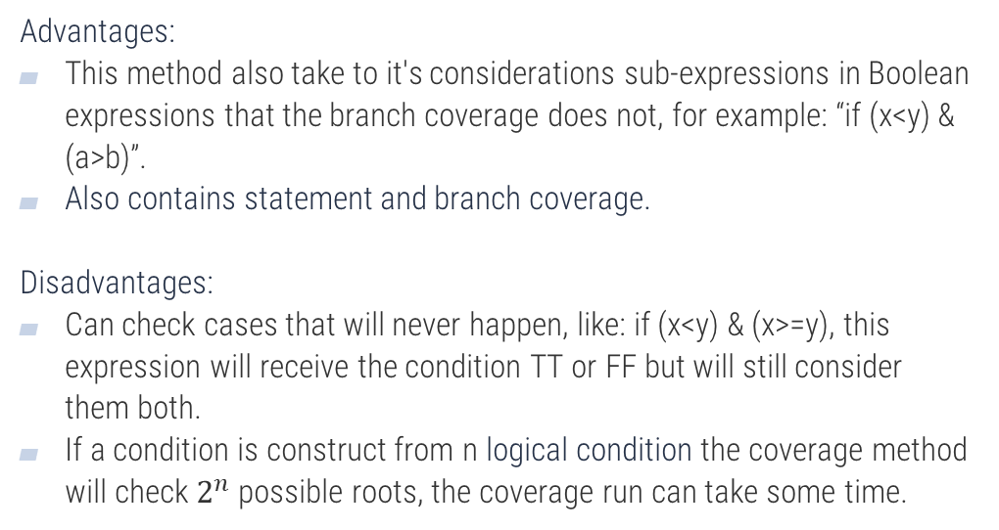
Advantages and disadvantages:
Advantages:
This method also take to it's considerations sub-expressions in Boolean expressions that the branch coverage does not, for example: “if (x<y) & (a>b)”.
Also contains statement and branch coverage.
Disadvantages:
Can check cases that will never happen, like: if (x<y) & (x>=y), this expression will receive the condition TT or FF but will still consider them both.
If a condition is construct from n logical condition the coverage method will check $2^{n}$possible roots, the coverage run can take some time.

Slide 19
Coverage methods Summary
We saw how for the same code and test suit we can get different coverages, depending on the features that each method take to it's considerations:
Method | Coverage percentage
Statement coverage | 75%
Branch coverage | 50%
Condition coverage | 25%

Slide 20
Asynchronous Coverage

Slide 21
Asynchronous Coverage
There is a common problem which occurs in testing code coverage of async tasks: if an async task is already completed at the time the code is being covered, it will appear as if the statement was not covered.
A solution for this problem can be found online on various forums, but my favorite one came from an underground programming blog by Bernhard Richter.
Bernhard suggests that the solution to this problem can be adding an extension to the Mocking library used in the tests, that when it handles an async task, it will force continuation of the task and make sure it does not complete before the time of running this statement.

Slide 22
Our Test Coverage

